Slide 1
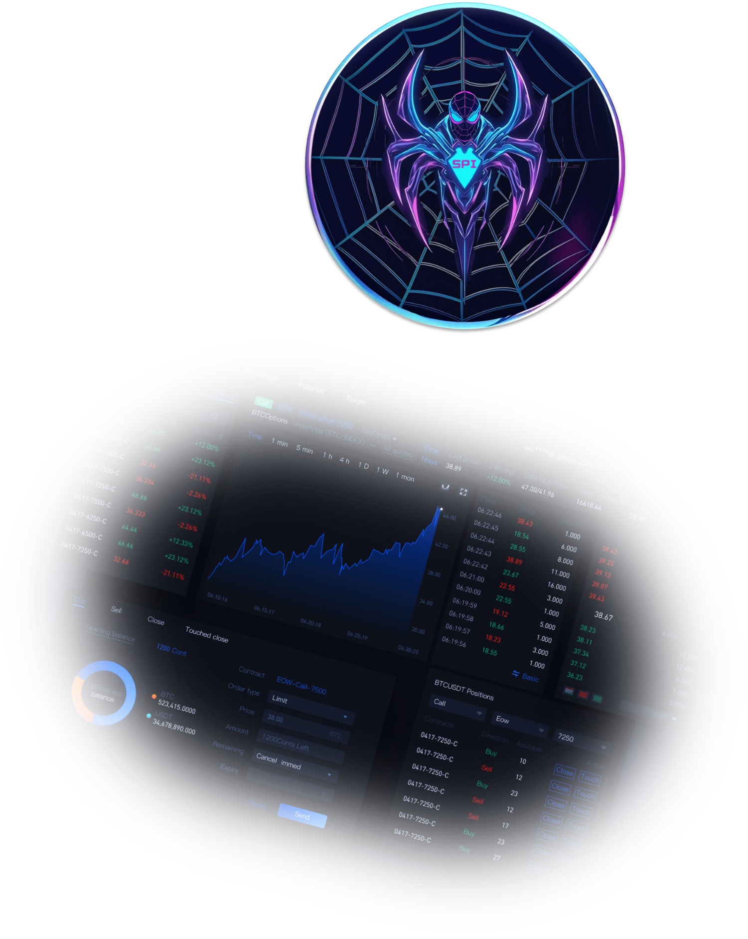
SpiderMan
Powered by native token SPI
White Paper Version1.0

Slide 2
Content
01 Project Summary
1.1 SpiderMan System Architecture
1.2 System Core Benefits & Features
02 Functions & Features
2.1 Definition and Functions of AI Robots
2.2 Technical Background: Robotics and Node Listening
2.3 Main features: automated trading, cost-effectiveness, security control
2.4 Contract trading service
2.5 AI Intelligent Order Taking + Intelligent Delivery Service
03 Technology & Security
3.1 Encryption Technology and Data Protection
3.2 Security Measures
3.3 API and Third Party Integration
3.4 Platform Execution Environment
04 Economic Model
4.1 SPI Token Base Attributes
4.2 Token Utility and Functionality
05 Technical Membership
06 Disclaimer
--------------------------
03-06
----------------------
07-16
---------------------
17-23
--------------------------
24-26
--------------------
27-29
---------------------------------
30-32

Slide 3
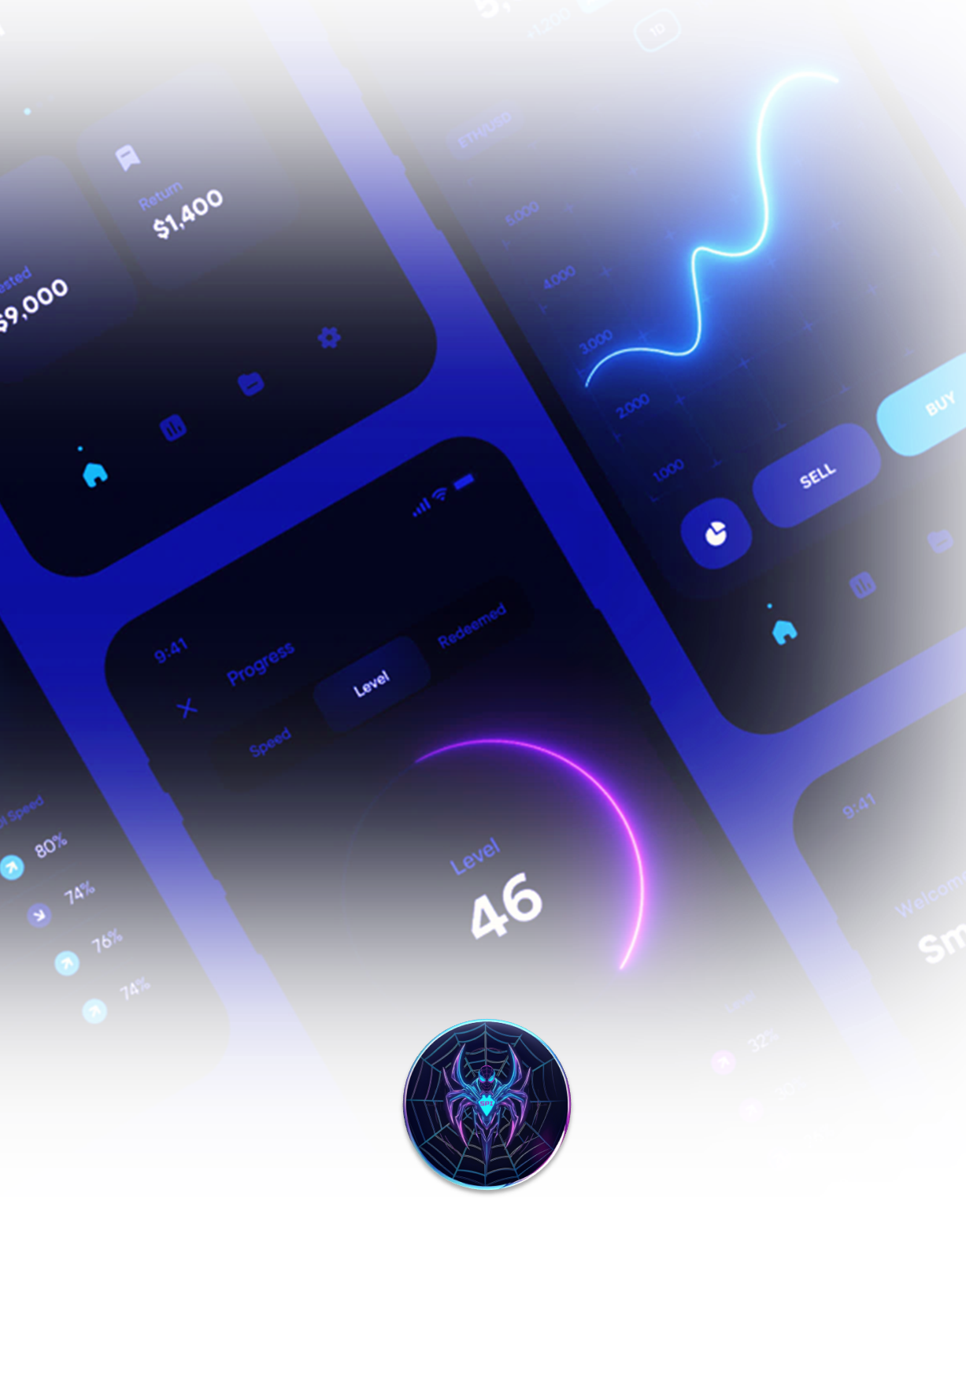
01
Platform Overview

Slide 4

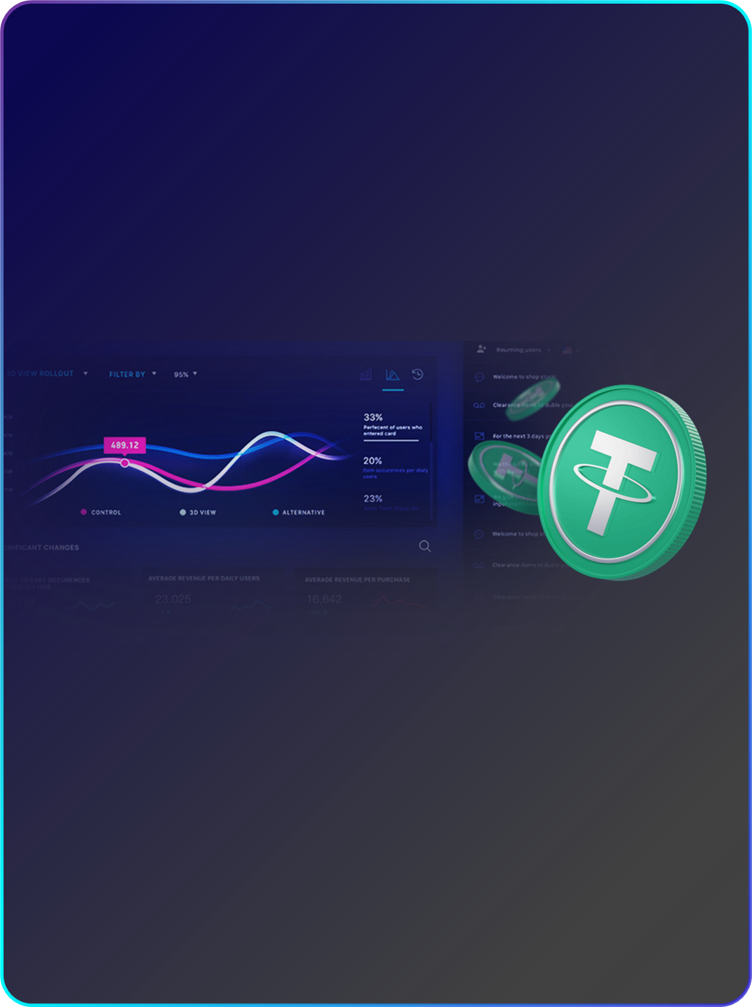
01 Project Summary
1.1 SpiderMan System Architecture
SpiderMan is an innovative digital asset trading system designed to provide users with secure, stable and efficient trading services. The system combines advanced blockchain technology, smart contracts and artificial intelligence (AI) technology to create a comprehensive and multi-functional cryptocurrency ecosystem. SpiderMan's core objective is to meet the investment and trading needs of different users around the world through a wide range of products and services, while ensuring a high level of security and compliance.
A) Front-end Application Layer
The user interface part provides a friendly interactive interface and supports multi-system (web, mobile, etc.) access. The front-end application communicates with the back-end server through a RESTful API to ensure real-time and accurate data.
B) Transaction Engine
The core component is responsible for summarizing the user's buy and sell orders. The trading engine adopts high-performance algorithms, supports multiple order types (limit orders, market orders, stop-loss orders, etc.), and is capable of handling high concurrency of trading requests to ensure low latency and high efficiency of trading.

Slide 5

C) Account Management System
Responsible for user account management, including user registration, identity verification (KYC), account fund management, etc. The system utilizes multi-level security measures such as two-factor authentication (2FA) and encryption to ensure the security of user funds. The system adopts multi-level security measures, such as two-factor authentication (2FA) and encryption technology, to ensure the security of user funds.
D) Wallet System
Used to manage the storage and transfer of various cryptocurrencies. The wallet system utilizes a cold and hot wallet separation mechanism to ensure that the majority of assets are in the cold wallet to enhance security. The wallet system integrates multi-signature technology to enhance the protection of funds.
E) AI Trading System
Using artificial intelligence technology to analyze market trends and user trading behavior, the AI system provides users with intelligent trading recommendations and automated trading services. the AI system is based on machine learning algorithms for self-optimization, aiming to improve the accuracy of trading decisions.
F) Data Analysis and Risk Control System
The system monitors trading data and market dynamics in real time and provides data analysis and risk control functions. The system uses big data technology and the Complex Event Processing (CEP) engine to identify abnormal trading behavior and prevent market manipulation and fraudulent activities.

Slide 6

1.2 System Core Advantages & Features
A) High Performance and Availability
SpiderMan adopts a high-performance transaction engine that is capable of handling large-scale concurrent transaction requests to ensure timely transactions. At the same time, the system architecture is designed to support flexible expansion and resource deployment according to market demand to maintain high system availability.
B) Advanced Security Mechanism
The system adopts multi-level security measures, including SSL encryption, DDOS protection, multi-signature wallets, and separation of hot and cold wallets, to ensure the safety of users' funds and data. The operation of the system will strictly comply with KYC and AML policies to ensure compliant operation.
D) Intelligent Trading and Automated Services
Through the integration of AI trading system, the system provides users with intelligent trading suggestions and automated trading services to help users optimize their investment strategies and improve trading returns.
Multi-module: data collection and processing, trading strategy, automated execution
Market data collection: real-time quotes, multi-exchange data
Quantitative strategies: mean reversion, trend following, arbitrage
Machine Learning Models: Deep Learning, Reinforcement Learning Adaptive Optimization
Risk control mechanism: stop-loss, take-profit, position management
Real-time monitoring and alerts: anomaly detection, risk alerts
Intelligent execution engine: efficient summarization, intelligent contracts
Multi-market access: support for automated trading of multiple trading pairs

Slide 7
02
Functions
& Features

Slide 8
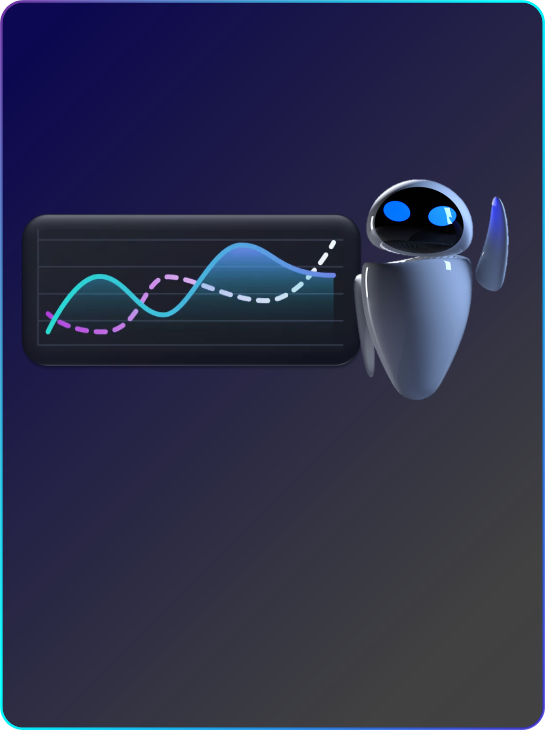
02 Features & Functions
2.1 Definition and Functions of AI Robots
An AI robot is an advanced automated trading system designed specifically for the decentralized financial (DeFi) market. It combines sophisticated algorithms and smart contract technology to automate sophisticated trading strategies on various exchanges (DEX and CEX).
A) Real-time market monitoring
In-depth market analysis: Robots continuously analyze market data, including price trends, volume, depth of trade and liquidity. Quickly helps to identify market trends and potential trading opportunities.
Responding to Market Changes: Responds quickly to small fluctuations in the market, capturing those critical moments that may be favorable to investors.
B) Rush Trade Execution
High-speed trade execution: When large trades are detected, the robot is able to quickly execute buy or sell trades before other market participants by boosting the Gas Fee.
Exploiting Price Fluctuations: The strategy is designed to capitalize on price movements by staying ahead of market dynamics, thereby realizing profits in a short period of time.

Slide 9
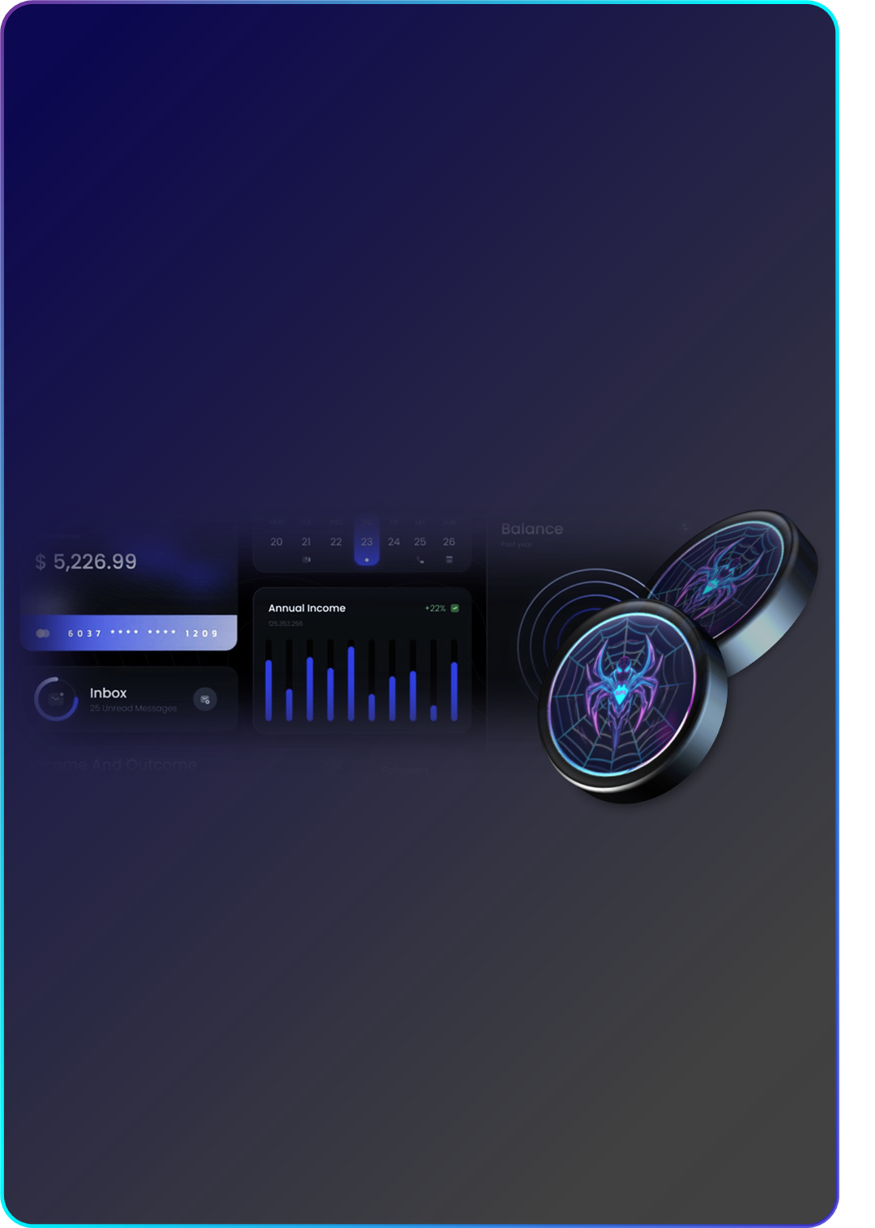
C) Arbitrage operations
Cross Platform Arbitrage: Execute fast trades between different exchanges, or even between different pairs within the same exchange, to capitalize on price differences.
Strategy Diversity: Robots can run multiple arbitrage strategies simultaneously, including bilateral arbitrage and more complex triangular arbitrage.
D) Risk Management
Dynamic Stop Loss / Take Profit: By setting dynamic stop loss and take profit points, the robot can automatically close trades to minimize losses or lock in profits.
Capital Management: For each trade, the robot will carefully manage the invested capital according to the pre-set risk tolerance and capital allocation strategy.
2.2 Technical Background: Race to the Top Technology and Node Listening
The core advantage of AI robots lies in their advanced run-scrambling technology and node-listening mechanism, which, in combination, provide a powerful trade execution and market analysis capability.
A) Head Start Technology
Prediction and Execution: Using advanced algorithms, robots can predict large trades that are about to occur. This prediction relies on in-depth analysis of market data and pattern recognition capabilities. Once such a trading opportunity is identified, the robot will quickly execute buy and sell orders to beat the market response.

Slide 10
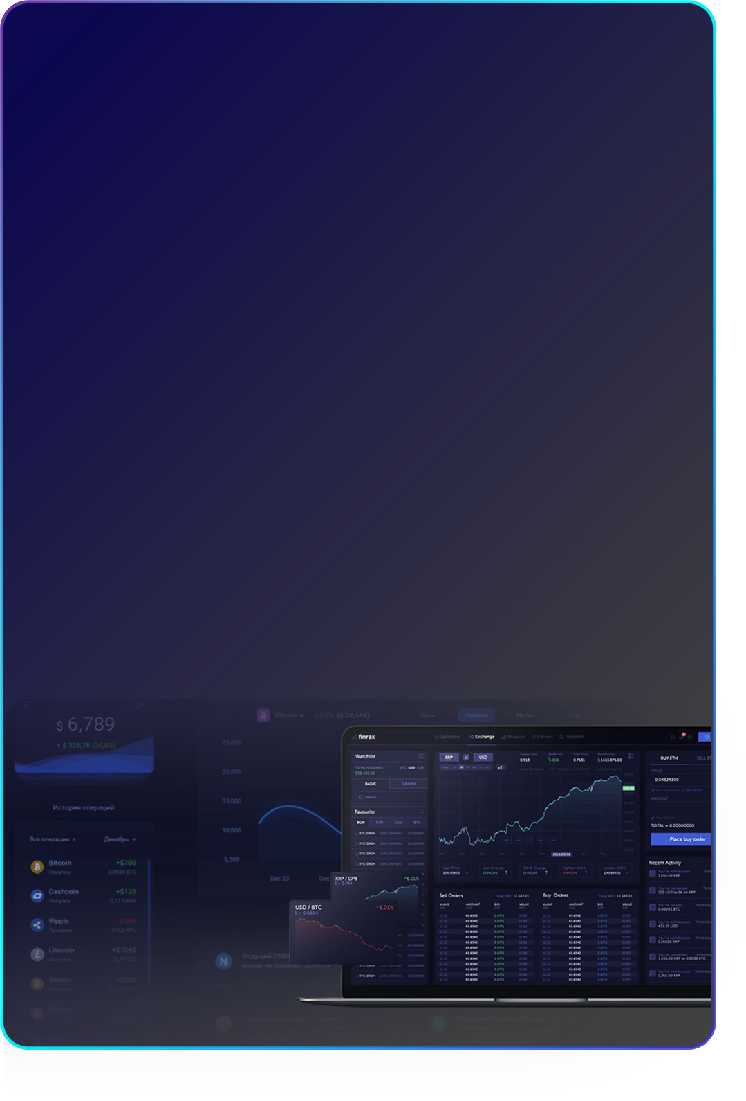
Algorithm Optimization: SpiderMan is constantly optimizing its algorithms in order to increase the accuracy of its predictions and the speed of trading. These algorithms can process large amounts of data and make complex decisions quickly to ensure that you are one step ahead of the game when it counts.
B) Node Listening
Real-time data acquisition: AI robots monitor transactions in the pool in real-time by connecting to different nodes of the blockchain network. This monitoring is not only limited to the number and size of transactions, but also includes the types of transactions and the market dynamics associated with them.
Market Motion Analysis: By analyzing transactions that are about to be packaged into blocks, the bot can anticipate upcoming changes in the market. This ability enables it to react before most market participants, thereby gaining a trading advantage.
C) Integrated Applications
Efficient Synergy: The combination of run-grabbing technology and node monitoring allows SpiderMan robots to execute trades quickly and accurately. This is achieved through efficient data processing and complex algorithmic optimization, ensuring an advantage in a highly competitive market environment.
Risk Reduction: Although the technology is highly dependent on algorithms and market data, through continuous testing and optimization it reduces the likelihood of erroneous trades and lowers overall trading risk.

Slide 11
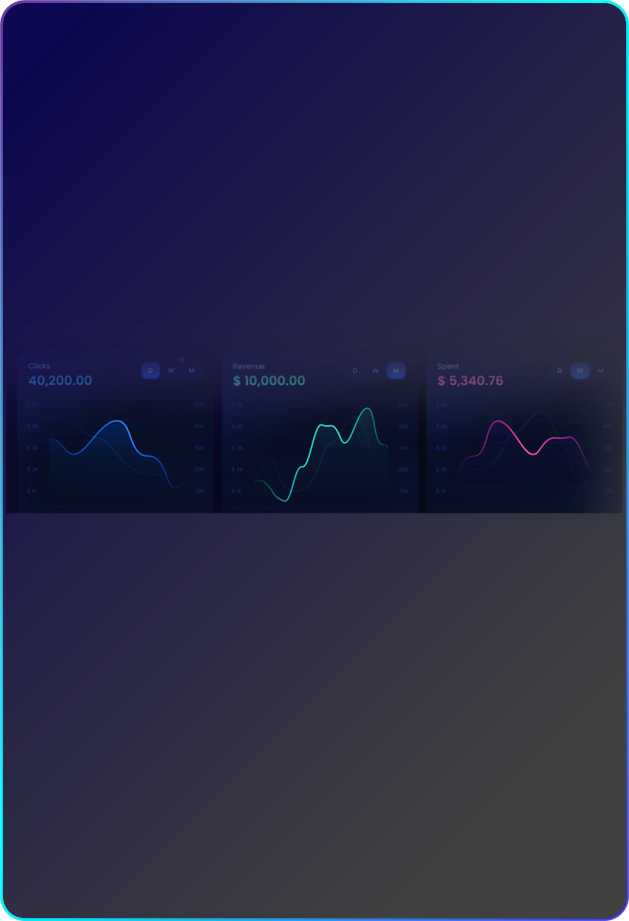
2.3 Key Features: Automated Transactions, Cost Effectiveness, Security Controls
A) Automated Trading
Advanced Algorithmic Driven: SpiderMan uses advanced algorithms to drive trading decisions. These algorithms are based on market data and predictive models, and are capable of automatically recognizing and executing complex trading strategies without human intervention.
High-frequency trade processing: The robot is designed to handle a large number of high-frequency trades, increasing trading efficiency and significantly improving market response time. This processing capability is particularly suited to the dynamic and fast-changing DeFi market environment.
High-speed data processing: The robot is able to process and analyze a large amount of market data in real-time, including price changes, trading volume, depth of orders, etc. It uses highly efficient data processing algorithms to ensure quick response and real-time trading strategy updates.
Algorithmic Optimization: Optimized trading algorithms for high-frequency trading scenarios, using advanced mathematical models and statistical analysis to predict market trends and optimize trading decisions.
Low Latency Trade Execution: Designed to minimize trade execution latency by connecting directly to major exchanges and liquidity pools to ensure fast execution of trade orders.
Real-time Market Adaptation: Monitor market dynamics in real-time to quickly adapt to market fluctuations, such as rapid price changes caused by breaking news or economic events.
Automated Risk Management: Integrate automated risk management features to automatically adjust positions and trading strategies during market fluctuations, such as automatically reducing trade size or implementing stop-loss strategies.

Slide 12

B) Cost Effectiveness
Gas Fee Optimization: When executing a transaction, SpiderMan algorithmically optimizes the Gas fee to reduce the transaction cost. This optimization is achieved by analyzing network congestion and transaction urgency to ensure that each transaction is executed at the most reasonable cost.
Optimal Trade Timing: The algorithm also determines the best time to trade to maximize profit potential. This includes analyzing market trends and price fluctuations, as well as predicting optimal buy and sell points.
C) Security Controls
Multi-Level Security Measures: In order to protect the security of user assets and trading data, UNI Intelligence 3.0 has implemented multi-level security measures. These include encrypted communications, thorough auditing of smart contracts, and strict validation of each transaction.
Risk Management Tools: A range of risk management tools are integrated, such as stop-loss limits and dynamic market monitoring. These tools help to prevent significant losses and to adjust trading strategies in case of unfavorable market conditions.
These features of SpiderMan combine to form a powerful trading tool. Automated trading ensures fast and efficient market participation, increased cost-effectiveness helps to keep trading profitable, and security controls guarantee the safety and security of the entire trading process. In the dynamic and ever-changing DeFi market, these features make UNI Intelligence 3.0 an indispensable tool for bringing stable and substantial gains to users while minimizing risk.

Slide 13
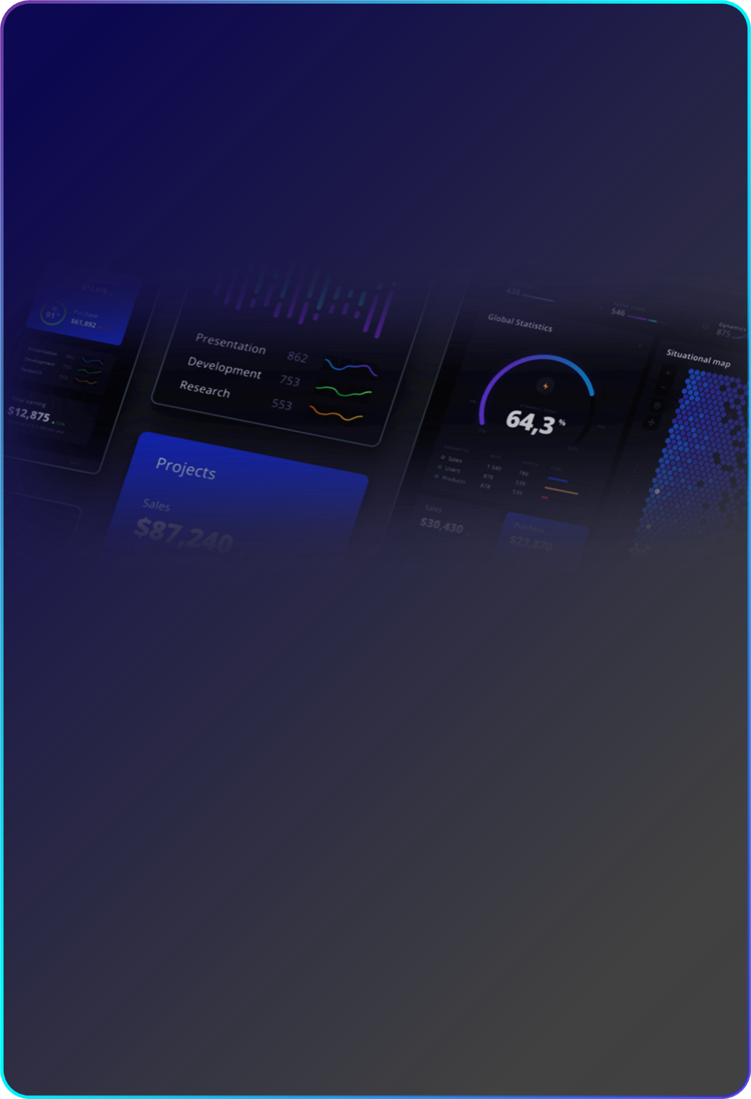
2.4 Contract Trading Services
Contract trading provides users with the opportunity to participate in the cryptocurrency derivatives market. By trading futures and perpetual contracts, users can invest in cryptocurrencies based on predictions of future price movements. Contract trading adds depth and liquidity to the market, while providing users with a tool for hedging risk and speculation.
A) Futures Contracts
A futures contract is a standardized financial contract that allows users to buy or sell a certain amount of cryptocurrency at a predetermined price on a specific date in the future. This type of contract is traded on an exchange and has a high degree of transparency and liquidity. Users can utilize futures contracts for risk management by locking in the price of future purchases or sales to hedge against price fluctuations.
B) Perpetual Contracts
A perpetual contract is a special type of futures contract that mimics the economic effects of a traditional futures contract but has no expiration date, allowing the user to hold the contract indefinitely. This type of contract usually includes a leverage feature that allows the user to control a large amount of cryptocurrency with a small initial investment, thereby magnifying returns if the forecast is correct. However, the use of leverage also increases the potential risk of loss. Perpetual contracts are highly liquid and offer almost 24/7 trading opportunities for traders who are looking for flexibility and high leverage.

Slide 14

C) Contracts for Difference (CFDs)
Contracts for Difference (CFDs) provide seamless access to the cryptocurrency market, allowing traders to speculate on the price movements of Bitcoin as well as other crypto assets without actually holding them.
Leveraged Trading: Through CFDs, SpiderMan offers adjustable leverage options, ranging from the more conservative 2:1 leverage to the extremely risky 100:1 leverage, to accommodate traders with varying risk tolerances. High leverage can magnify gains as well as losses, so SpiderMan is equipped with advanced risk management tools to help users manage their risk exposure.
Pricing Transparency: The platform offers fully transparent pricing for all CFD products, based on market supply and demand, combined with liquidity pools and order book depth.
D) Leveraged Spot Contracts
Traders can choose the level of leverage to trade spot contracts that suits their risk appetite. The wide range of leverage options provides flexibility in terms of capital efficiency and market exposure.
Cost of Positions: Another feature of leveraged spot contracts is the cost of positions, which represents the expense incurred in borrowing funds, SpiderMan offers competitive cost of positions to encourage traders to utilize leverage while remaining cost effective when taking long term positions.
Risk Limitations: High leverage carries a certain amount of risk, and tools are provided to limit these risks, such as automatic position closure, margin calls and a multi-level risk alert system.

Slide 15
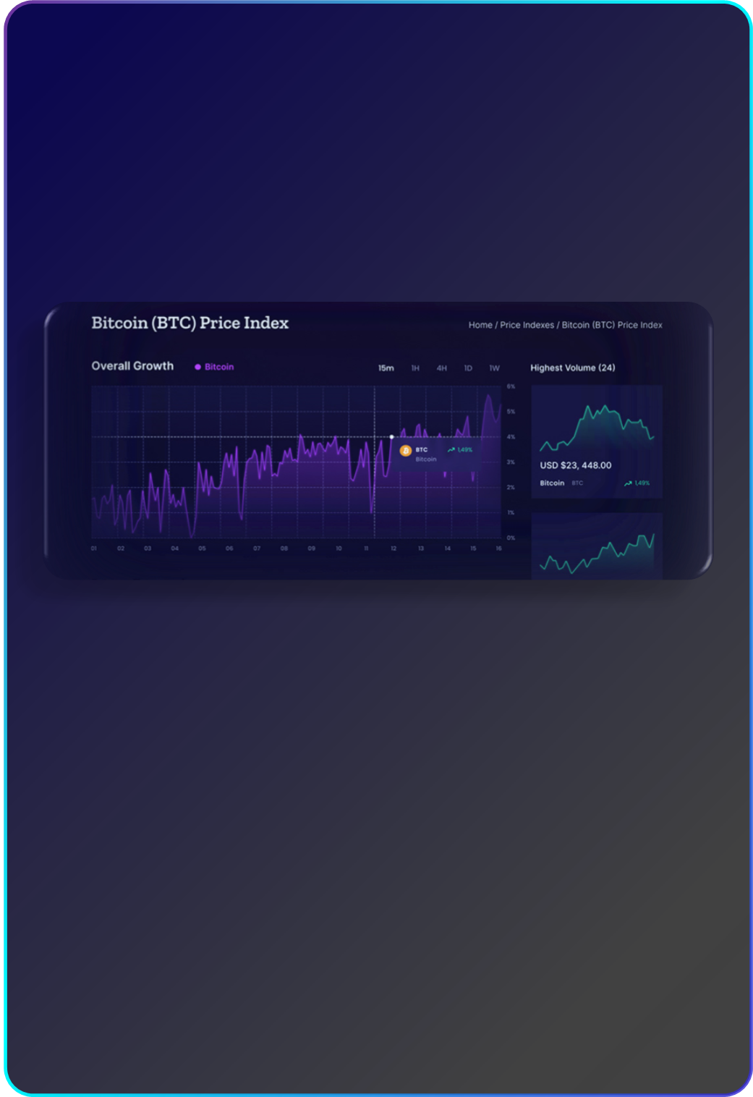
2.5 AI Intelligent Order Taking + Intelligent Delivery Service
In the context of the 24-hour high-speed operation of the cryptocurrency market, SpiderMan breaks through the traditional trading model, using AI algorithms as the brain and smart contracts as the neural network to create a one-stop closed-loop service of strategy generation, automatic order-following, and accurate delivery. Users do not need to keep an eye on the market and do not need codes to enjoy an institutional-level trading experience, realizing a double leap in asset allocation efficiency and risk control level.
A) Multi-dimensional Market Sensing
Integrating real-time data on the chain (large transactions, capital flows), macroeconomic indicators and public opinion and sentiment, AI processes millions of data points per second, and dynamically constructs long and short game models.
B) Personalized Strategy Generation
Based on the user's risk preference (conservative/aggressive), trading cycle (intraday/swing/long-term) and asset class (mainstream currency/cottage currency/NFT), AI automatically generates differentiated trading strategies, and supports one-click cloning of top traders.
C) Intelligent Risk Management
Built-in melting - hedging - dynamic leverage three-level risk control system, when the market fluctuation exceeds the preset threshold, the AI automatically triggers the stop profit and loss, strategy execution failure rate <0.03% (industry average >5%).

Slide 16

D) Zero Friction Order Execution
By automatically matching the best liquidity pools (Uniswap, Coinbase Swap, etc.) with smart contracts, the order matching time is shortened to 10ms, and the slippage control is 90% lower than that of traditional platforms.
E) On-chain Asset Delivery Protection
Contract locking is triggered upon completion of transaction, and combined with cross-chain atomic exchange technology (e.g. Polkadot XCMP), instantaneous clearing of multiple asset classes (ETH/USDT/BTC, etc.) is realized, thus eliminating the risks of delayed withdrawals and third-party custodianship.
F) Traceable Audit of the Whole Process
Every transaction record is uploaded and stored, and users can view the strategy testing, fee allocation and fund flow in real time through the SpiderMan DAO governance interface, which makes the operation completely transparent.

Slide 17
03
Technology & Security

Slide 18
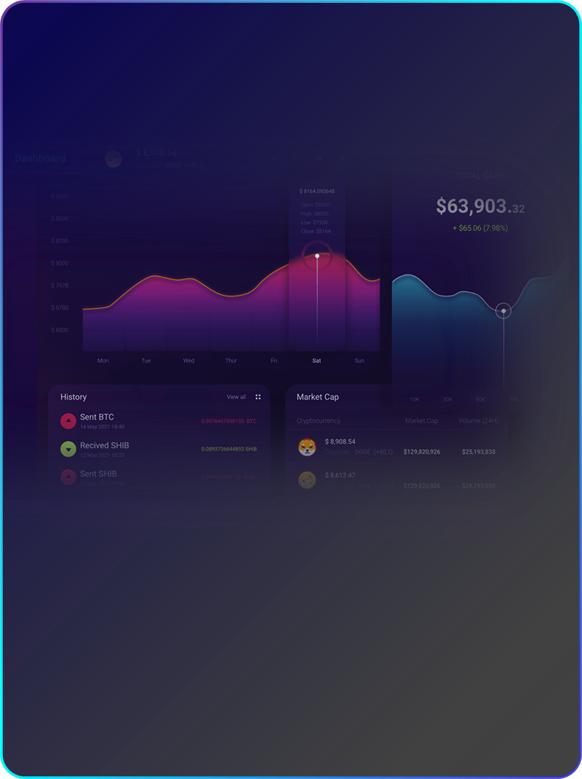
03 Technology & Security
3.1 Encryption and Data Protection
A) Multi-layer encryption technology
SpiderMan uses a layered encryption strategy to ensure information security. In addition to the standard SSL/TLS transmission encryption, the team also implements the AES-256 encryption standard, which is considered the most secure encryption method today. For critical data, such as subscriber private keys, the team utilizes a double encryption mechanism to ensure that even if the data is compromised, it will not be easily decrypted.
B) GDPR Compliance
In order to fully comply with GDPR requirements, SpiderMan has established a comprehensive data management and review system. This includes regular data cleansing, retaining only essential data and ensuring that data is deleted in a timely and complete manner upon user request. The technical team also implements strict data access control to ensure that only authorized personnel can access user data, and complete access logs are kept for future auditing.
C) Endpoint Protection Technology
In addition to the encryption of the central server, the endpoint protection technology makes it difficult for attackers to access critical transaction data even if they are able to hack into the user's device.

Slide 19
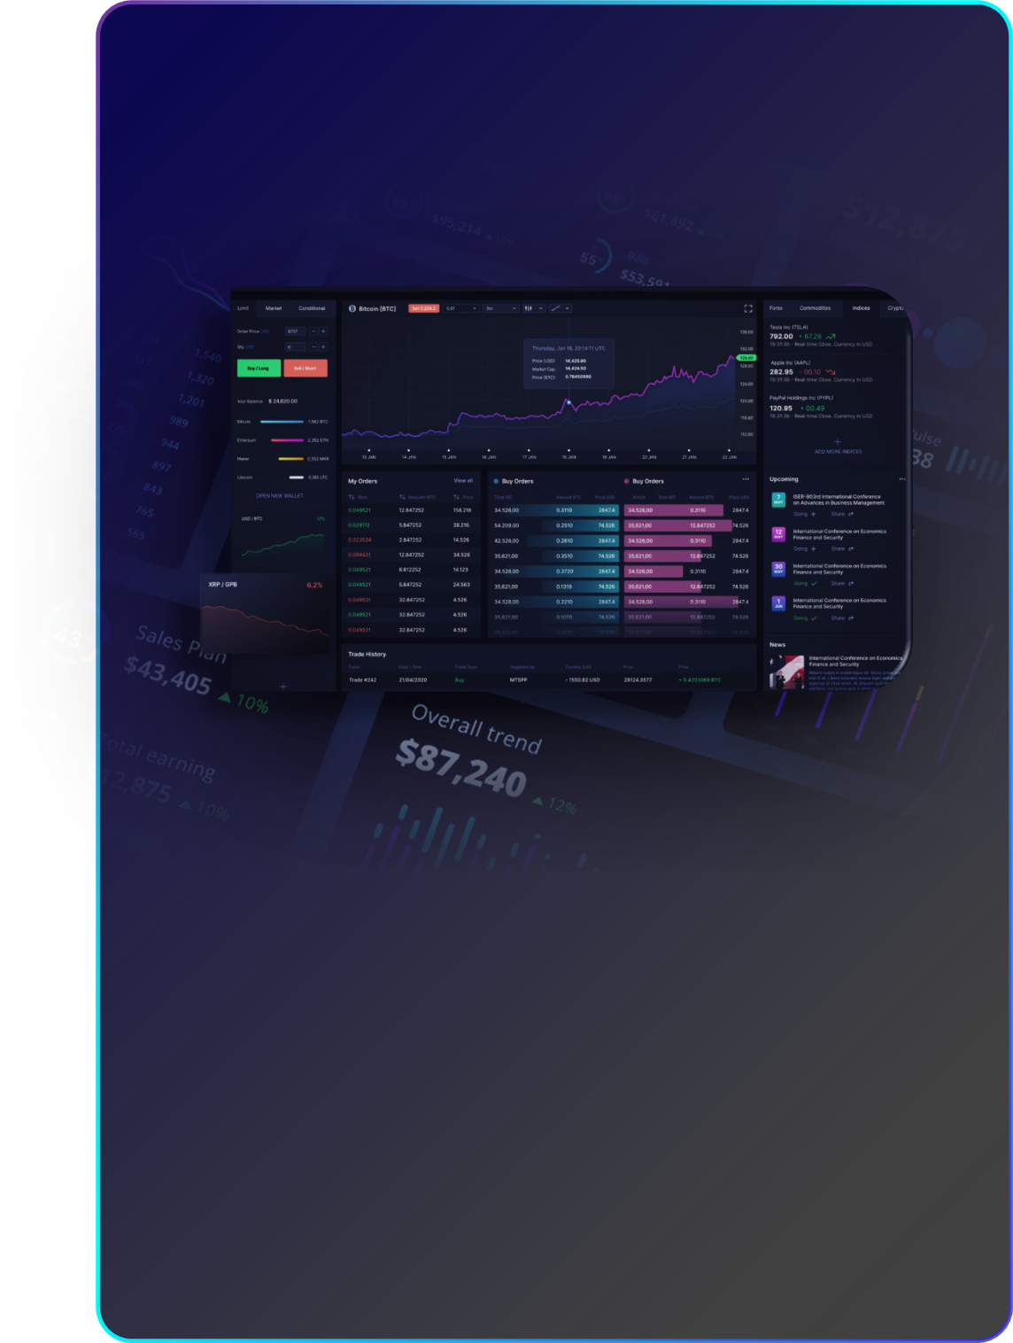
D) Zero-knowledge technology
SpiderMan introduces zero-knowledge proof for certain transactions and data queries. This means that users can prove that they have a certain data or meet certain conditions, without having to reveal the specific data content, further enhancing privacy protection.
3.2 Security Measures
A) DDoS Protection
SpiderMan deploys a multi-node decentralized protection system. This not only means that the technical team can quickly identify the characteristics of DDoS attacks, but also that even if some nodes are attacked, other nodes can still work normally, ensuring the stability of the overall system. The technical team also utilizes high defense bandwidth to effectively mitigate the pressure of heavy traffic attacks and ensure that platform services are not affected.
B) Real-time Risk Monitoring
We use sophisticated machine learning algorithms to analyze all trading activities in real time. Any abnormal patterns, such as sudden large transfers or unusual login behavior, will be immediately detected and trigger an alert, while the account activity may be temporarily frozen for further investigation.

Slide 20

C) Multi-factor Authentication
In addition to conventional SMS or hardware token authentication, SpiderMan introduces biometrics such as fingerprint and facial recognition. It also supports the use of time-based one-time password (TOTP) mechanism to ensure that even if the authentication code is intercepted, it cannot be used by an attacker at another moment.
D) Ongoing Security Audits
Collaboration with third parties is not limited to security audits; the technology team introduces “white hat” hacking and bounty programs that encourage external experts to identify potential security vulnerabilities for the technology team. Any identified vulnerabilities are rewarded appropriately, ensuring that the technology team's systems are continually and thoroughly tested.
E) End-to-End Encryption
SpiderMan ensures that all user data is encrypted from sender to receiver, including all communication with the server, thus avoiding man-in-the-middle attacks.
F) Hardware Security Module (HSM)
All key management and encryption operations are carried out in the HSM, which is highly protected physically and logically, ensuring that critical data will not be compromised by the external environment.

Slide 21
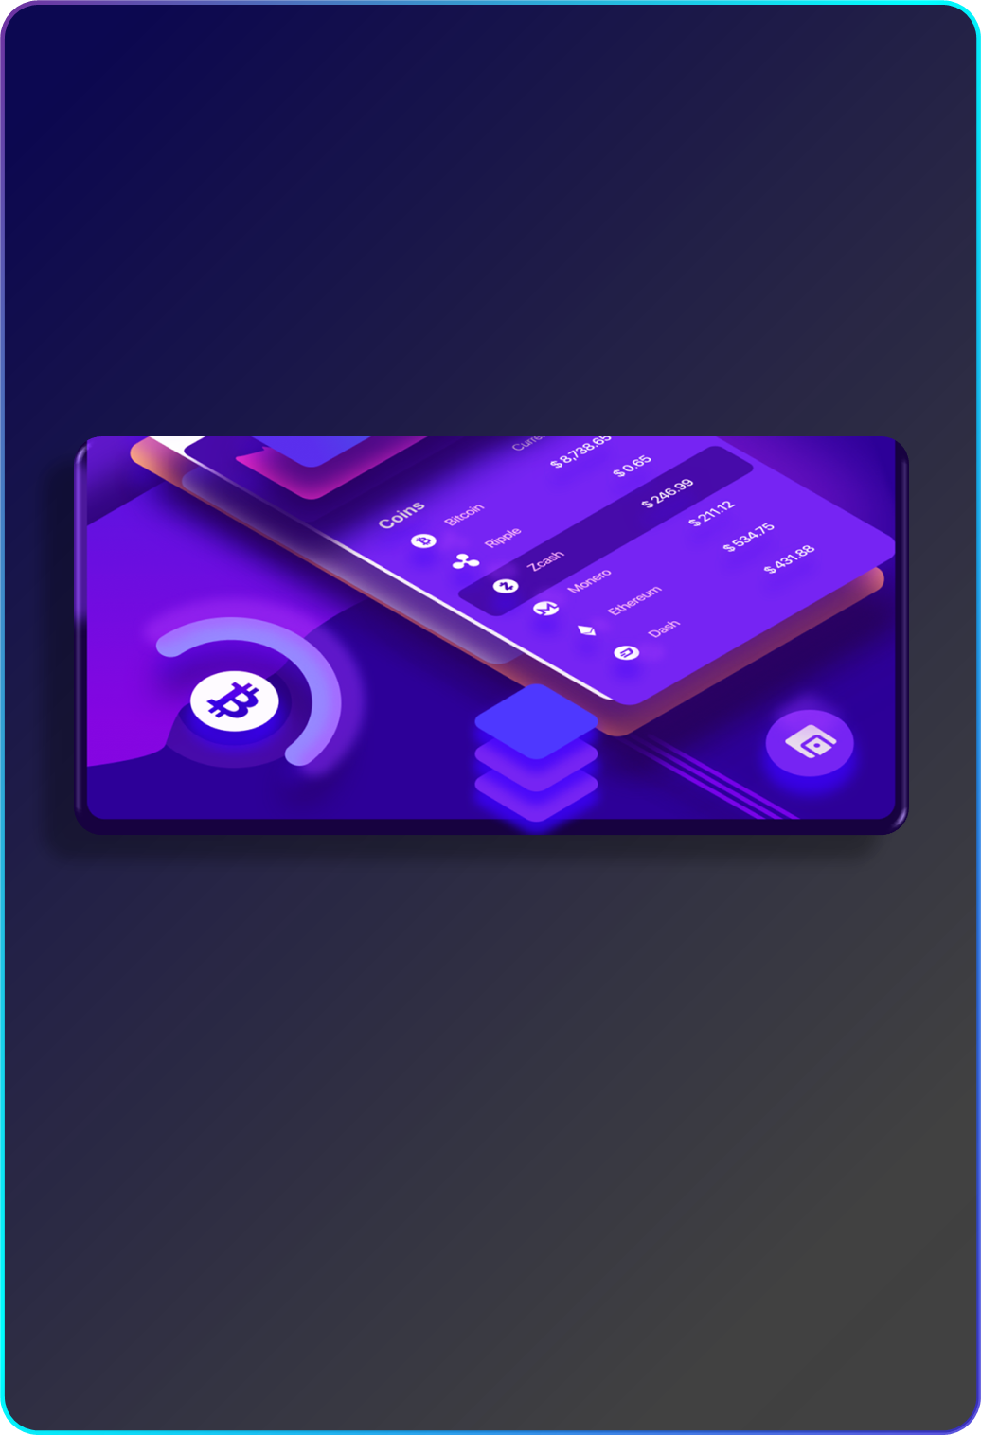
3.3 API and Third Party Integration
A) Open API Design
SpiderMan is committed to providing high-end investors and financial institutions with open, flexible and customized trading solutions. After many rounds of technology research and development and market research, SpiderMan API is known for its low latency, stability and compatibility with a wide range of applications.
B) Functionality and Performance
SpiderMan's API supports high-frequency trading and real-time data transmission, and is perfectly suited for algorithmic trading, dynamic hedging and other complex trading strategies with its accurate and timely data transmission capabilities. The platform's APIs provide developers and fintech entities with powerful tools to easily implement programmatic trading, strategy backtesting and advanced algorithmic applications on the SpiderMan platform.
C) Integration with Third Party Software
SpiderMan's API does not exist in isolation, but rather serves as a bridge between third-party software and financial applications. It allows seamless interfacing with a wide range of tools and services, including smart trading robots, integrated asset management systems, and blockchain-related Dapps.

Slide 22
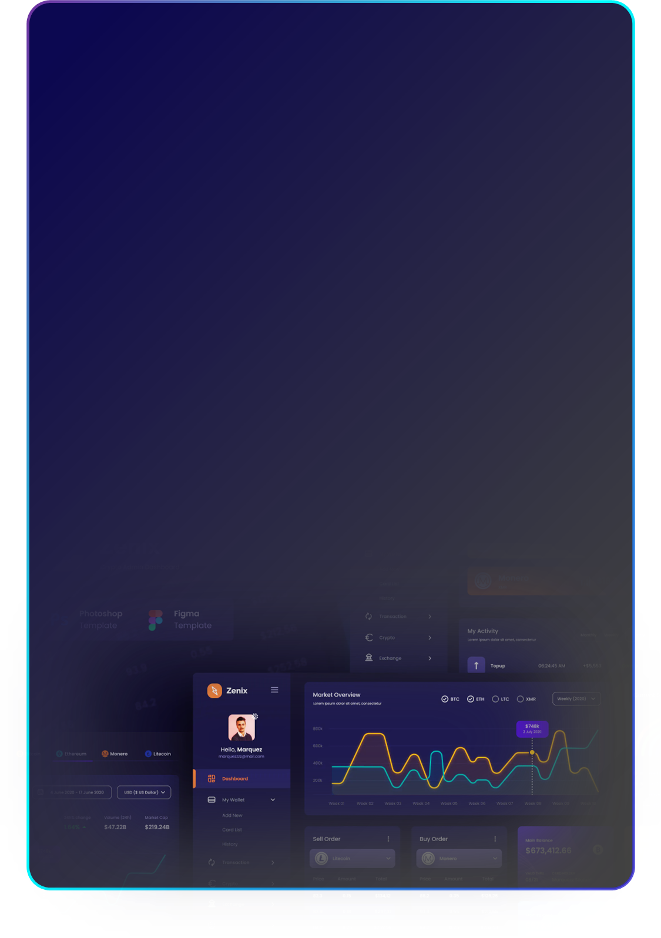
3.4 Platform Execution Environment
A) Secure and isolated execution environment
The SpiderMan system emphasizes security and stability in the execution of smart contracts. Each smart contract has an independent execution environment when running on SpiderMan system, and the operation of the contract will not have any direct impact on the main network or other running contracts. The isolation mechanism will increase the overall security of the network and ensure that each contract can run in a stable and reliable environment, reducing the risk of unexpected interruptions or failures.
B) Virtual Machine Optimization
On SpiderMan, special attention has been paid to the efficiency and performance of smart contract execution. Through special optimization of the virtual machine, the SpiderMan system significantly improves code execution speed, while effectively reducing resource consumption and improving memory management efficiency. The optimizations ensure that the system's performance and responsiveness remain optimal even when processing resource-intensive or logically complex smart contracts, providing a smooth and efficient user experience.
Code Execution Optimization: Speed up code execution with real-time compilation technology
Resource Management Improvement: Efficiently allocate and recycle resources to reduce waste.
Memory utilization optimization: memory management technology to improve utilization efficiency.
Concurrent Processing Capability: Support multi-threading and concurrent processing to enhance processing capability.
Security Enhancement: Enhanced VM security features to prevent attacks.
Adaptive Adjustment: Automatically adjust resources according to load and complexity.

Slide 23
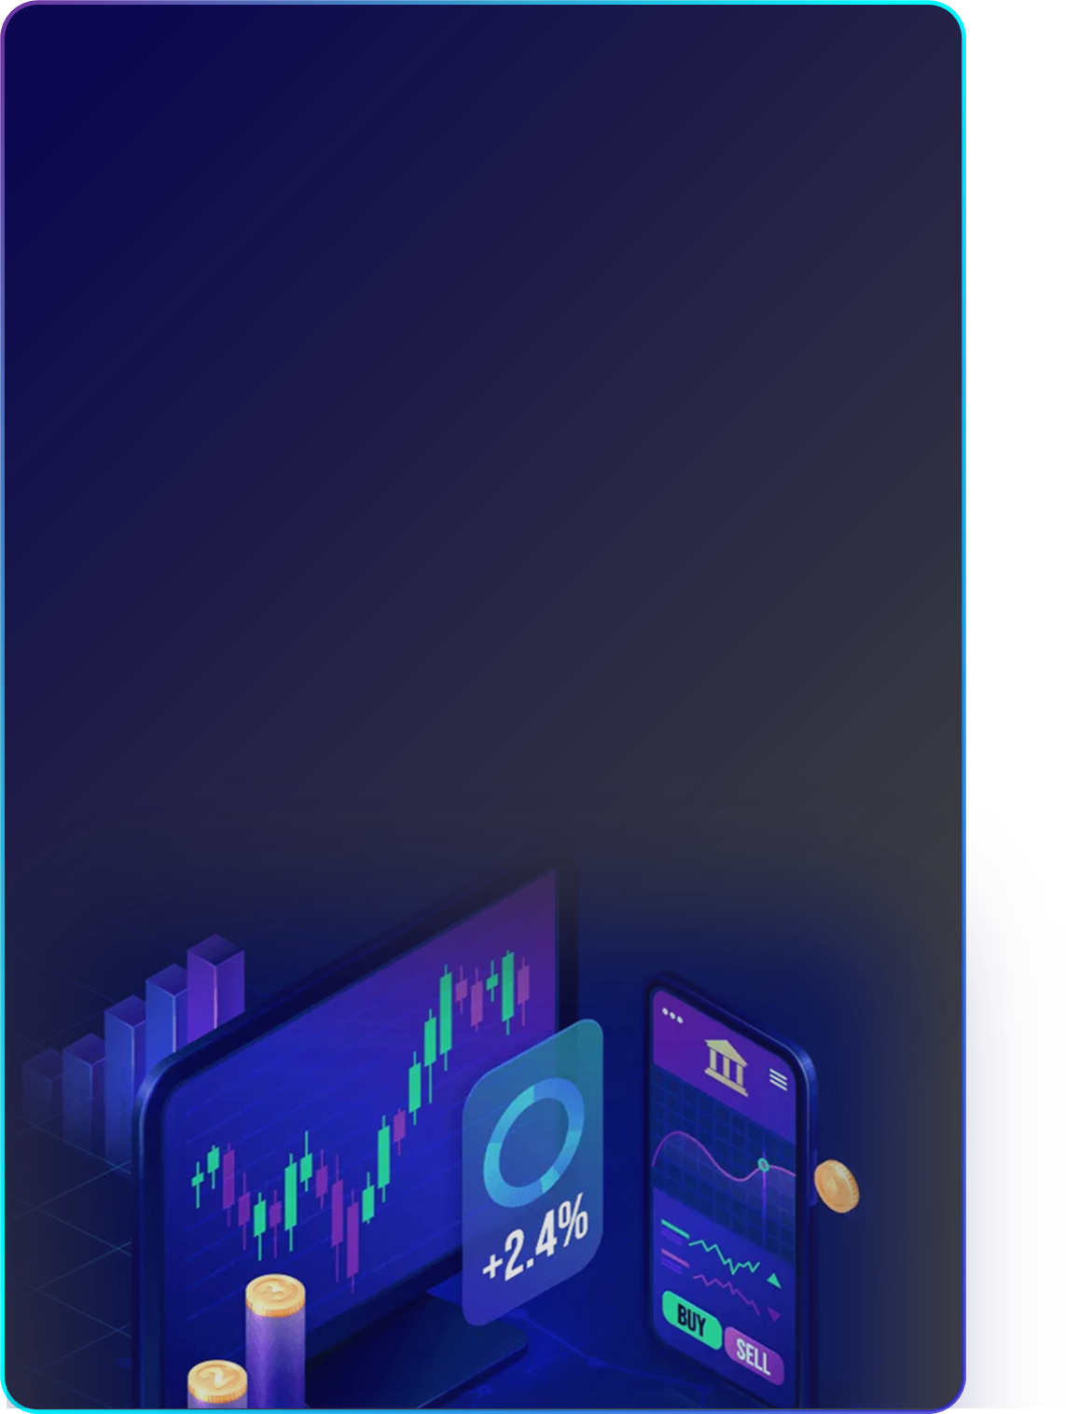
C) Error Isolation and Handling
SpiderMan's intelligent contract execution environment is equipped with an efficient error management and handling mechanism. Once an error or anomaly occurs during contract execution, the system is able to recognize and isolate it immediately, and at the same time, automatically start the error handling procedures, such as exception trapping and error logging. This mechanism not only protects the entire network from potential errors, but also provides automatic recovery capabilities to maintain continuous operation and stability of the network.
D) Compatibility and Scalability
SpiderMan has designed its smart contract execution environment with future technological developments and integration of new features in mind. While supporting multiple smart contract types, it also leaves room for contract upgrades and the addition of new features. This design not only provides developers with a wide range of options and flexibility, but also ensures that the system is able to adapt to future technological changes and market demands.
Whether it is traditional financial services, innovative decentralized applications, or new blockchain applications that may emerge in the future, the execution environment is able to provide support. Through continuous technical updates and optimization, the SpiderMan system will ensure its long-term competitiveness and adaptability in the blockchain field, creating a sustainable and progressive platform for users and developers.

Slide 24
04
Economic
Model

Slide 25

04 Economic Model
4.1 SPI Token Base Properties
SPI is an eco-governance token launched by SpiderMan, with a total volume of 10 billion coins, aiming to create an efficient, decentralized and sustainable crypto asset trading and governance system. As the anchor point of SpiderMan's ecological value, it empowers users to change from participants to ecological co-builders through DAO governance and open protocols, helping the cryptocurrency market move towards a more efficient and transparent future.
Name: SpiderCoin (SPI)
Code: SPI
Total Volume: 10 Billion (100,000,000,000,000)
Blockchain underlay: SpiderMan, a cross-chain native protocol built on the Cosmos SDK
Pledge Bonus | 10% | Holding and pledging SPI to participate in network governance, releasing 2% per year
​Air Drop | 4% | Airdrop to global users in three rounds, need to complete identity verification and KYC
​Liqudity | 1% | Continuous injection into mainstream exchanges (Binance/Coinbase/OKX)
​Develop-Fund | 5% | Decade of linear release (0.5% per year)
​Tech-Fund | 5% | Decade of linear release (0.5% per year)
​Eco-Fund | 70% | Targeted distribution through eco-partners (DEX/capital management organizations/NFT projects)

Slide 26

4.2 Utility and Functions of Tokens
A) Transaction fee deduction - reduce user costs and enhance network stickiness
Dynamic rate model: the basic transaction fee rate is 0.08%-0.15% (graded according to the order size), users can use SPI payment, real-time discounted market price.
Burning mechanism: 50% of the handling fee is automatically burned and destroyed, which is expected to reduce the supply of 3.5 billion pieces in ten years, combining with deflationary expectations to strengthen the long-term holding value.
B) Eco-governance - Empowering users' voice
Threshold participation: After accumulating a certain number of SPIs, users can unlock their voting rights on proposals and directly exercise their voting rights on core issues (e.g., optimization of the trading mechanism and allocation of ecological resources), breaking the “elite governance” barrier of traditional centralized platforms.
Transparent execution on the chain: All proposals are automatically executed through smart contracts, and the voting results are announced on the chain in real time, eliminating backdoor operations and creating a governance paradigm of “code is law”.
High-threshold consensus guarding: Users need to pledge a considerable amount of SPI (the specific threshold is dynamically adjusted according to network security) to become a verification node, and through the block and maintenance of network stability, they will be rewarded by the block and receive a share of the transaction fee, forming a governance closed loop of “benefit sharing and risk sharing”.

Slide 27
05
Technical
Members

Slide 28



05 Technical Members
Porter Smith
Porter specializes in DeFi, governance design, and practical applications across the crypto space. A graduate of Stanford University, he is a veteran full-stack developer specializing in creating high-performance applications using React and Node.js. He previously worked at Netflix, where he was involved in the design and implementation of several front-end projects.
Jun Hong Lin
Lin is a senior software engineer with extensive experience in web development and cloud computing. He graduated from National Tsing Hua University, Taiwan, majoring in Computer Science, and received his M.S. degree in Computer Engineering from National Chiao Tung University, Taiwan. He is currently responsible for the development and maintenance of enterprise applications.
Samuel Wright
Samuel is a veteran database administrator with deep technical experience in MySQL and PostgreSQL. He received his degree from the University of Florida and has worked on Uber's data team, managing large-scale data infrastructures.

Slide 29



Jeremy Richardson
Jeremy holds a Master's degree in Computer Science from Columbia University. He has over 8 years of experience in big data analytics and machine learning, with a specialization in complex data sets. Prior to joining the project, he worked as a Senior Data Scientist at Salesforce, where he led several successful projects.
Patrick O'Donnell
Patrick is an accomplished software engineer with a degree in Computer Engineering from the University of Pennsylvania. He has an in-depth understanding of microservices and containerization technologies, and has worked with Docker to deliver container solutions to enterprises.
Oliver Peterson
A graduate of Stanford University, Oliver is a veteran full-stack developer specializing in creating high-performance applications using React and Node.js. He previously worked at Netflix, where he was involved in the design and implementation of several front-end projects.

Slide 30
06
Disclaimer

Slide 31
06 Disclaimer
Your choice to use SpiderMan and its services indicates your acceptance of the terms of this statement. Before you decide to continue, please make sure you read and understand the following.
A) Accuracy of Information and Services
In this fast-changing digital era, the accuracy of information and services has become a top priority for the platform. While the team continuously strives to update and maintain the accuracy of all information and services provided, please note that changes in the environment, market and technology may affect the timeliness of the relevant content. Therefore, the Platform strongly recommends that all content provided should be considered as reference information and not as an absolute basis for decision making.
B) External Links and Resources
As technology advances, the Internet has become more interconnected. In order to provide users with a more complete perspective, SpiderMan may contain links to external third-party websites or resources. While these links are intended to enhance your online experience, please understand that the Platform is not responsible for the accuracy, completeness or continuity of the content of these external links. These links are for informational purposes only and users should exercise the necessary caution when accessing these external resources.
C) Investment and Financial Advice
The complexity and volatility of the financial markets require that any advice and information be thoroughly considered. Although SpiderMan provides financial information and possible recommendations, these are based on the platform's current understanding and analysis. However, the uncertainty of the financial environment means that these recommendations should not be regarded as professional or legally binding guidance. Any investment decision involves a certain degree of risk, and the Platform strongly recommends that you consult with a financial expert or professional in the relevant field for more specific, in-depth advice before making a decision.

Slide 32
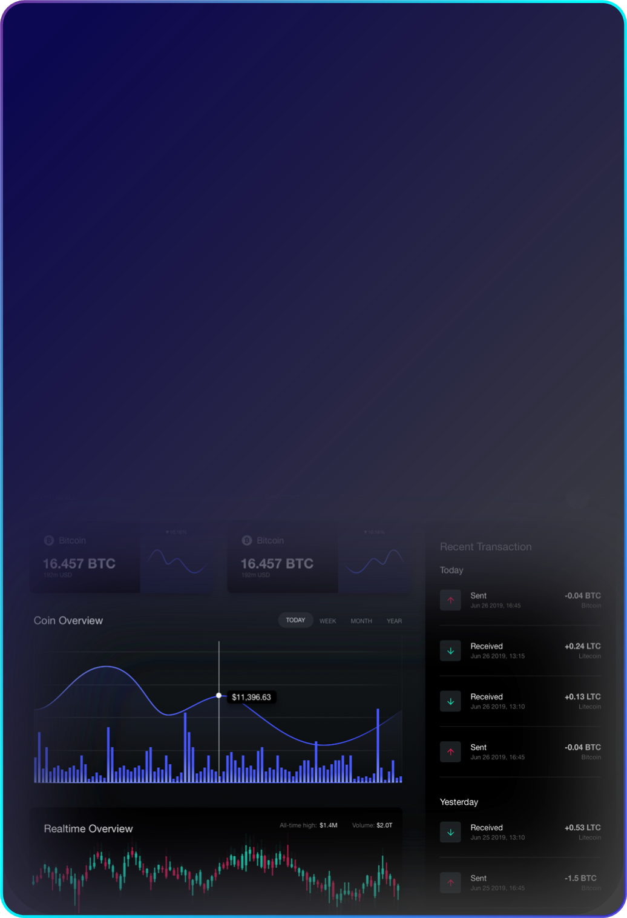
D) Technical Service Interruptions or Errors
Despite the Platform's efforts to ensure the stability of the Platform, the Platform's services may be subject to temporary interruptions or errors due to technical reasons, maintenance or other unforeseen factors. The Platform apologizes for any inconvenience this may cause, but please understand that the Platform is not liable for any loss incurred as a result.
E) Limitation of Liability
The Platform is committed to providing the highest level of service to its users, but unless expressly required by law, SpiderMan and its partners will not be liable for direct or indirect damages resulting from the use of, or inability to use, the Services.
(F) Changes to the Statement
The Platform may need to revise this Disclaimer from time to time due to business development and regulatory updates. The Platform recommends that you periodically return and review it to ensure that you are aware of the latest terms and conditions. By using the Platform's services, you agree to and accept this Disclaimer and any updates to it.

